Slide 1
Airbnb Data Analysis
Let’s Save Customers Some Money
Arpit Sharma
Sanman Yadav

Slide 2


Interested parties and Business Value
Customers – they can compare between different Airbnb rooms and nearby hotels
Airbnb – Competitive pricing, improving their service
Host – How can they improve their houses for a better customer service . Also beneficial for new hosts
Hotels – With growing popularity of Airbnb, Hotels can have competitive pricing to lure customers

Slide 3
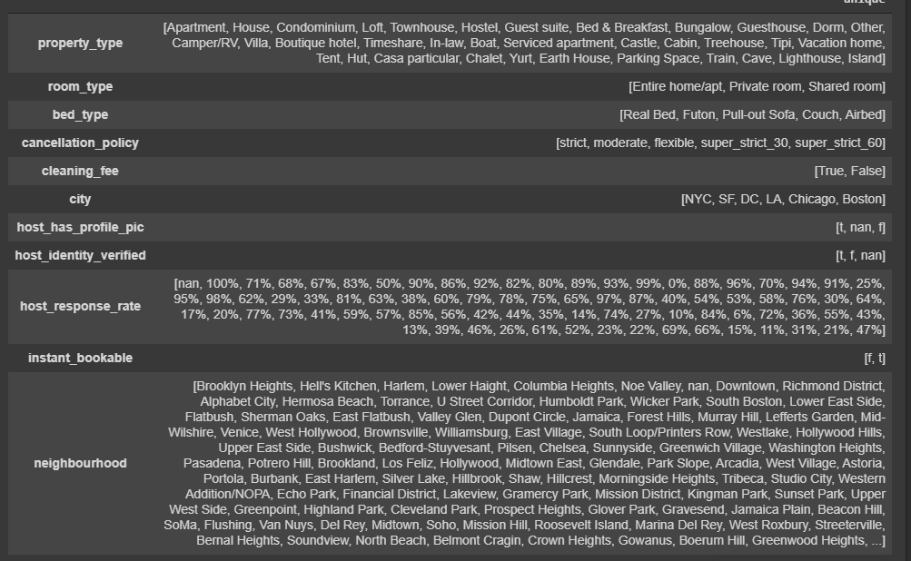
Data Exploration
Unique Values in Columns

Slide 4
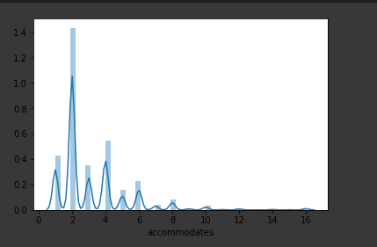
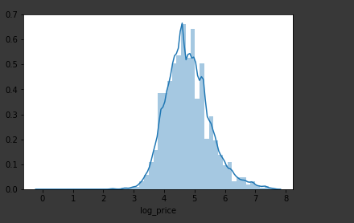
Data Exploration Cont.
Accommodates
Log Price DISTRIBUTION

Slide 5
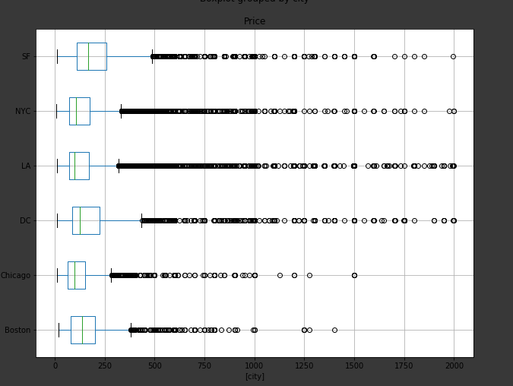
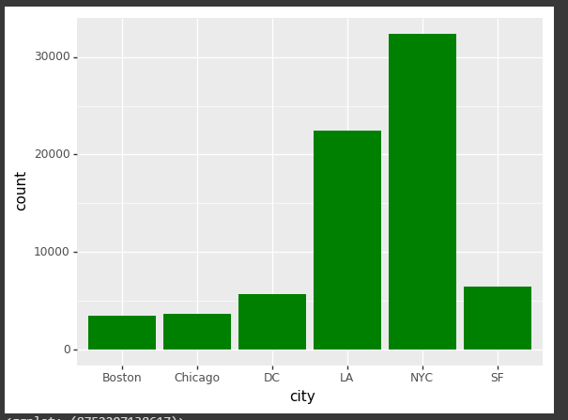
Data Exploration Cont.
City Bookings Boxplot
Most Bookings in A City

Slide 6
Target Variable No 1
The Log Price
What is a Logarithmic Price Scale?
A logarithmic price scale is a type of scale used on a chart that is plotted such that two equivalent price changes are represented by the same vertical distance on the scale.
The distance between the numbers on the scale decreases as the price of the asset increases.

Slide 7
Target Variable No 2
Cancellation Policy
Flexible
Moderate
Strict
Super strict

Slide 8


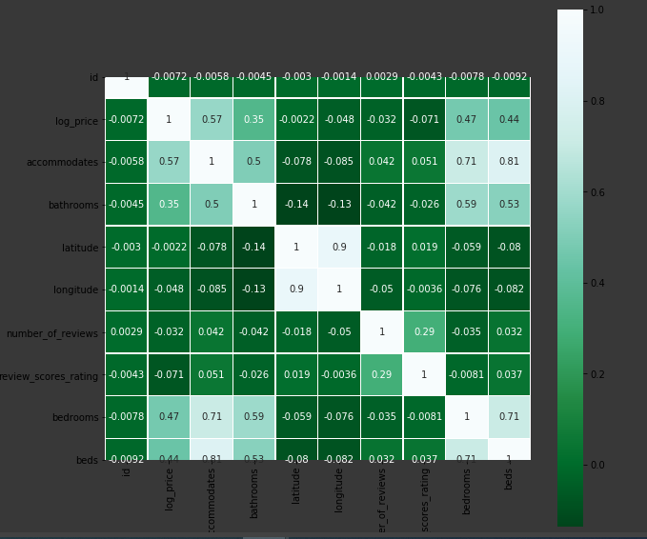
Correlation Matrix
As per correlation Matrix latitude, longitude, number_of_reviews and review_scores_rating are not making much Impact on LOG_Price
There is Also Correlation between Bathroom and Accomodates. We decided to keep acomodations

Slide 9
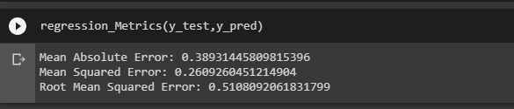
Random Forest
Used Random Forest on Log Price
Here we have used PCA

Slide 10
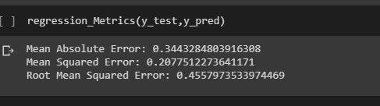
Gradient Boosting
Gradient boosting is a machine learning technique for regression and classification problems
Prediction model in the form of an ensemble of weak prediction models, typically decision trees.
Used Gradient Boosting on Log Price

Slide 11
Thinking Out of the Box
We realized after a closer look at the data set and doing PCA that some variables have a direct effect on how the prices of the houses are decided.
These variables are Room type, Bed type, Cancellation Policy, City, Instant Bookable
Since these variables could be converted into dummy variables, we created dummy variables for the same
For classification we took the mean of the log price. If it is lesser than the mean, we put it as zero, otherwise 1.

Slide 12
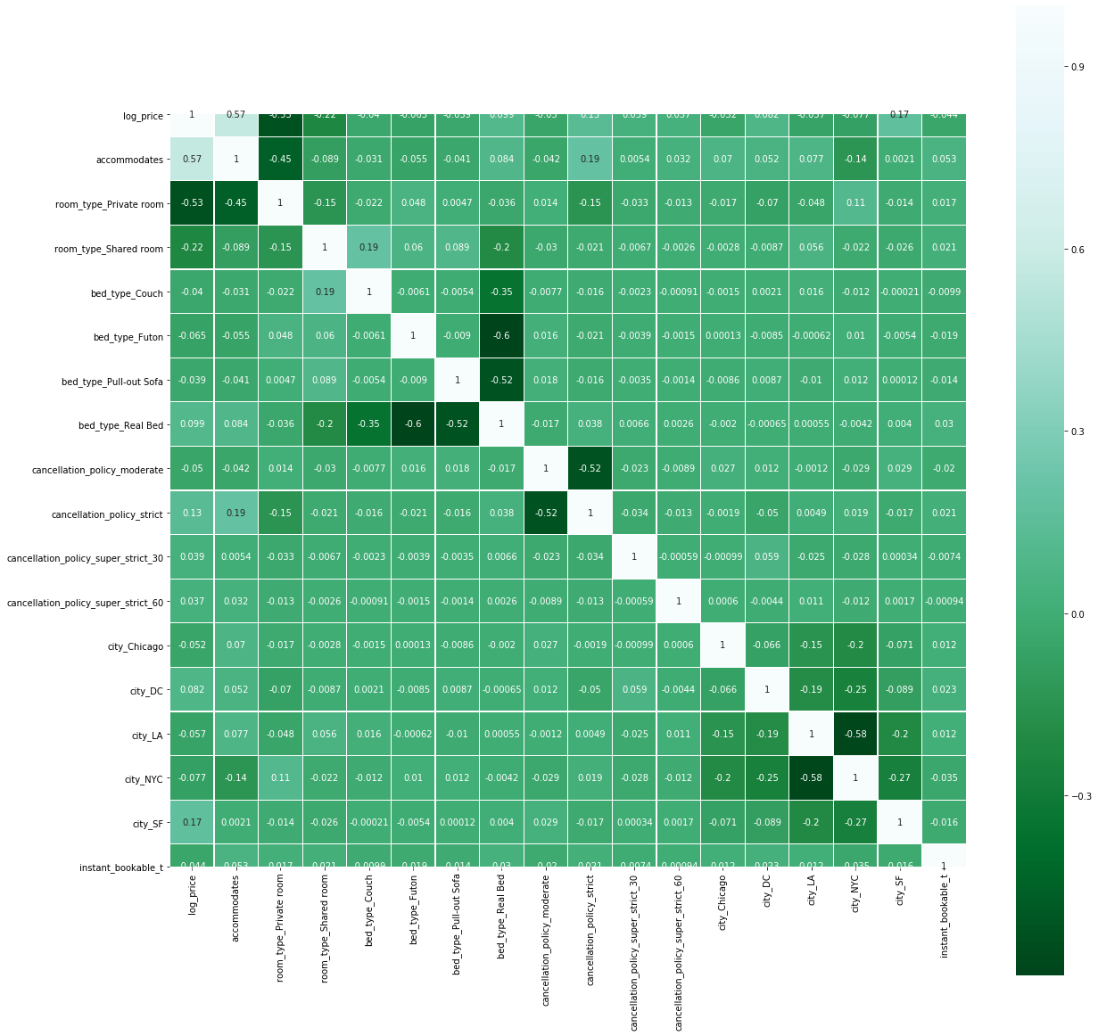
Correlation Matrix for the dummy variables

Slide 13

Interaction Terms
We also created some interaction terms
First is between bedroom, beds and bathrooms
Second is between reviews score rating and number of reviews

Slide 14
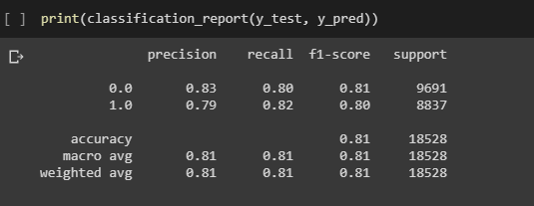
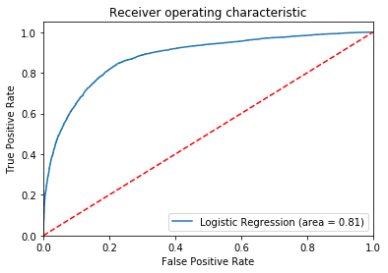
Logistic Regression

Slide 15
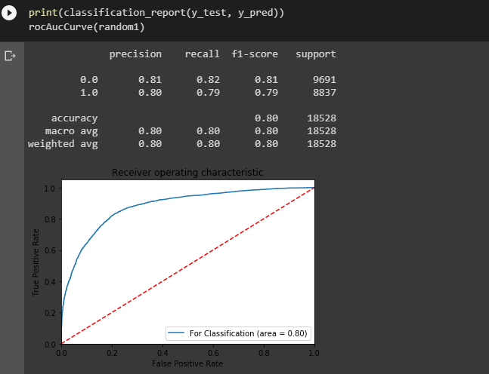
Random Forest

Slide 16
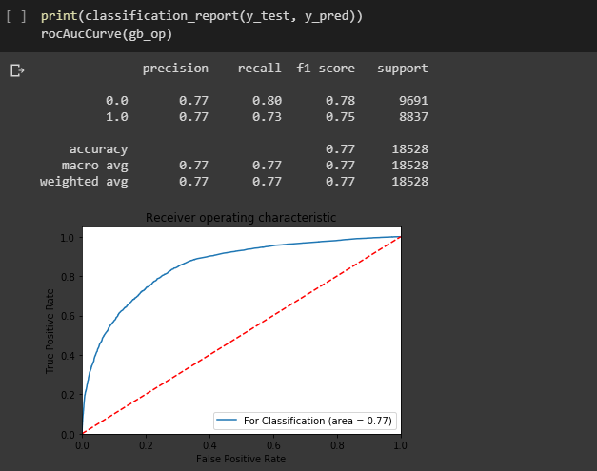
Gradient Boosting

Slide 17
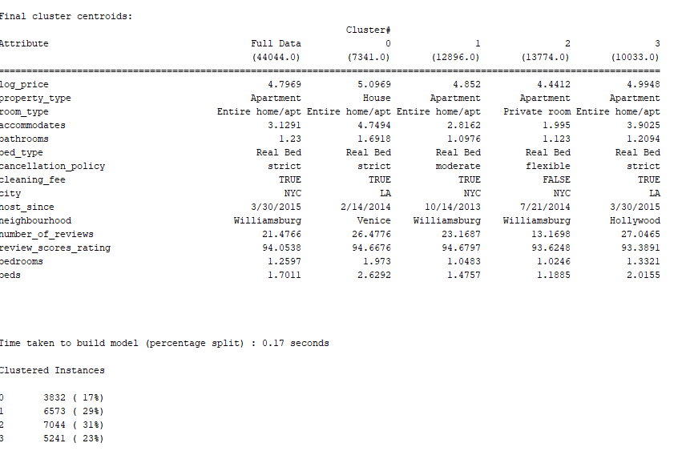
Clustering

Slide 18
Best Association Rules
Cancellation policy is flexible when city is NYC and property type is Apartment
Cleaning fee is TRUE when bed type is Real Bed
Cancellation policy is Strict when city is LA and property type is Apartment

Slide 19
Business Inferences – Setting up the prices
When looking at the log_price, with an error of 0.207(ie, $1.60 - $1.75), we can say that the given price of the house is over or below the present margin.
When a host wants to put listing and wants to see if the listing is below or above the mean price, with 81% accuracy, our model can predict if it is above or below the mean price.

Slide 20
Business Inferences - Customers
Customers can get insights about areas having strict cancellation policy and factors deciding it
There is usually no cleaning fee if the Bed type is anything other than a real bed (e.g. Couch, Futon, etc.)
The mean price of a certain area
Houses in San Francisco and DC generally have higher prices.
LA have the most lavish houses with costs of over $2000 per night and having 16 beds and 8 baths.
Book sharing or guest room to have a flexible cancelation policy

Slide 21


THANK YOU!!

